Slide 1
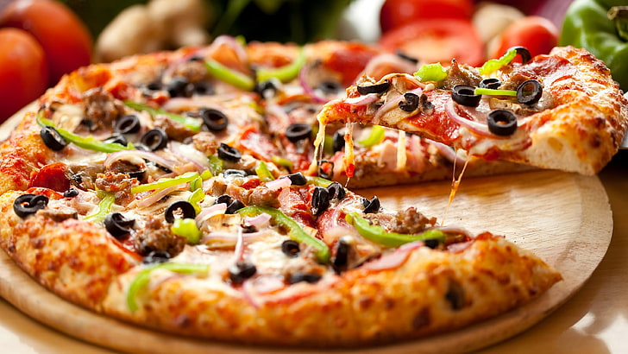
PIZZA SALES ANALYSIS
Understanding Trends and Opportunities
Presentation by
-Shweta Barnwal

Slide 2
Business Problem-
KPI’s Requirement
We need to analyze Key Performance Indicators for our Pizza Sales data to gain insights about the preference of customer and about business performance and growth etc.
Specifically we have to calculate some metrics for the insights/analysis
Total Revenue: The sum of the total price of all pizza orders.
Average Order Value: The Average amount spent per order, calculated by dividing the total revenue by the total number of orders.
Total Pizzas Sold: The sum of the quantities of all pizzas sold.
Total Orders: The total number of orders placed.
Average Pizzas Per Order: The average number of pizzas sold per order, calculated by dividing the total number of pizzas sold by the total number of orders.

Slide 3
Business Problem-
CHARTS REQUIREMENT
We would like to visualize various aspects of our pizza sales data to gain insights and understand key trends. We have identified the following requirements for creating charts.
Daily Trend for Total Orders: Create a bar chart that displays the daily trend of total orders over a specific time period. This chart will help us identify any patterns or fluctuations in order volumes on a daily basis.
Monthly Trend for Total Orders: Create a line chart that illustrates the hourly trend of total orders throughout the day. This chart will allow us to identify peak hours or periods of high order activity.
Percentage of Sales by Pizza Category: Create a pie chart that shows the distribution of sales across different pizza categories. This chart will provide insights into the popularity of various pizza categories and their contribution to overall sales.

Slide 4
Business Problem-
CHARTS REQUIREMENT
4. Percentage of Sales by Pizza Size: Generate a pie chat that represents the percentage of sales distributed to different pizza sizes. This chart will help us understand customer preferences for pizza sizes and their impact on sales.
5. Total Pizzas Sold by Pizza Category: Create a funnel chart that presents the total number of pizzas sold for each pizza category. This chart will allow us to compare the sales performance of different pizza categories.
6. Top 5 Best Sellers by Revenue, Total Quantity and Total Orders: Create a bar chart highlighting the top 5 best-selling pizzas based on the Revenue, Total Quantity, Total Orders. This chart will help us identify the most popular pizza options.
7. Bottom 5 worst Sellers by Revenue, Total Quantity and Total Orders: Create a bar chart showcasing the bottom 5 worst-selling pizzas based on the Revenue, Total Quantity, Total Orders. This chart will enable us to identify the less popular or underperforming pizza options.

Slide 5



PIZZA SALES ANALYSIS
By Using Power Bi

Slide 6
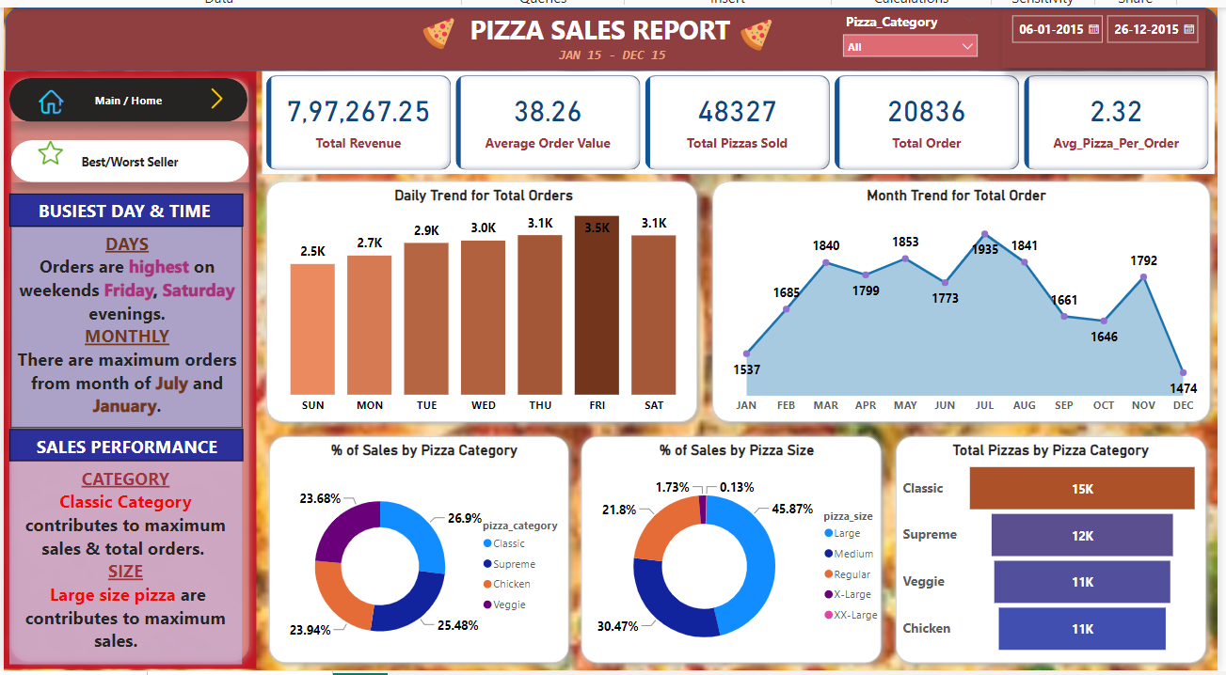

Slide 7
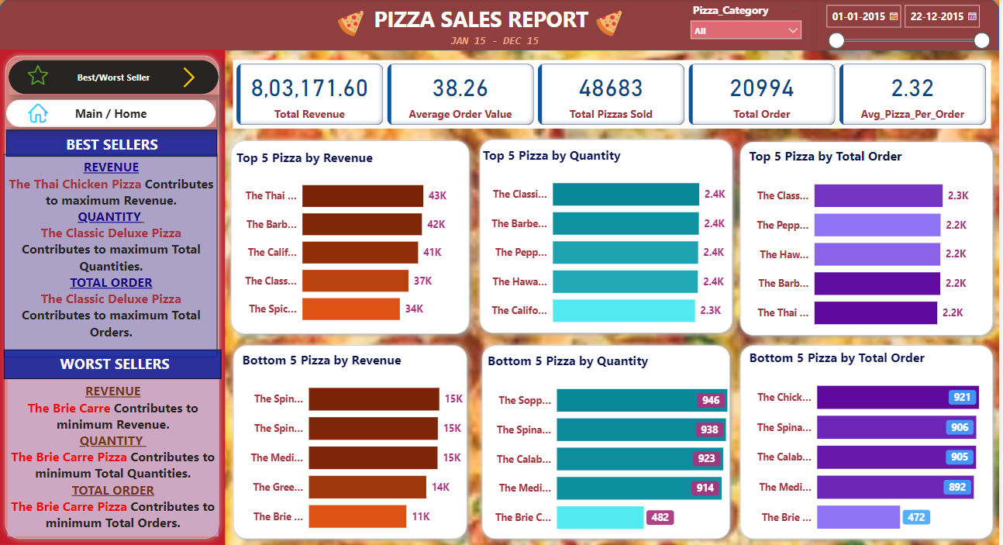

Slide 8



PIZZA SALES ANALYSIS
By Using SQL

Slide 9
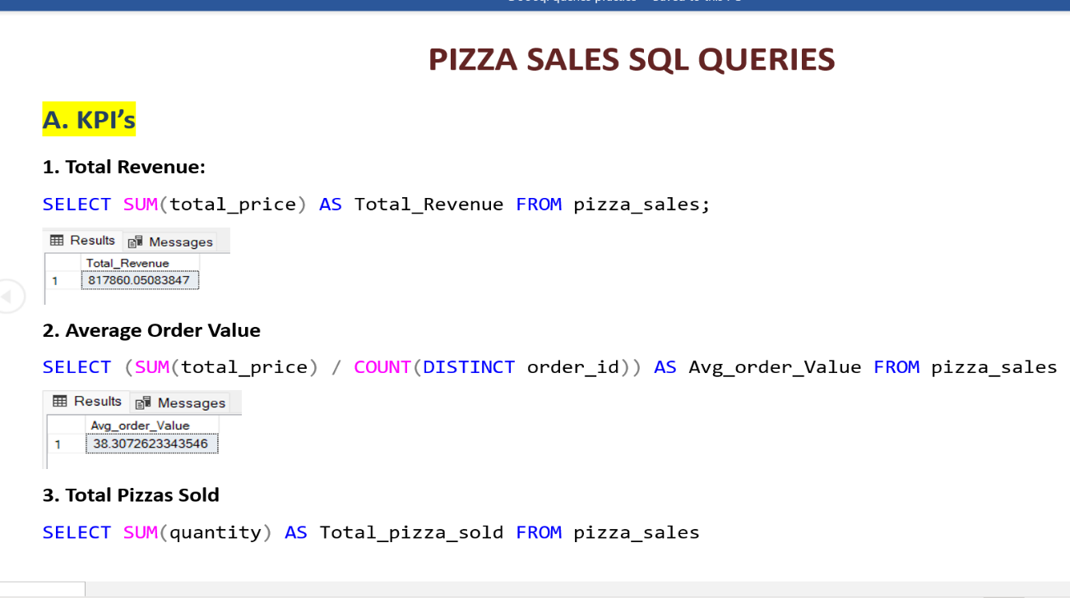
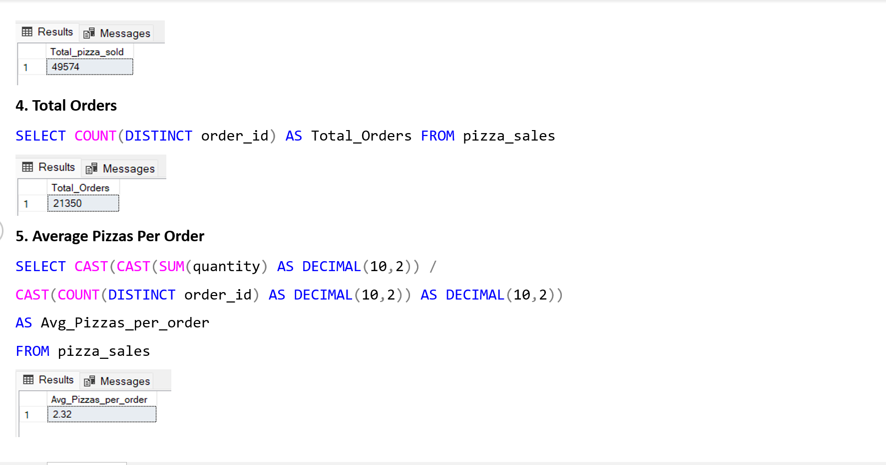
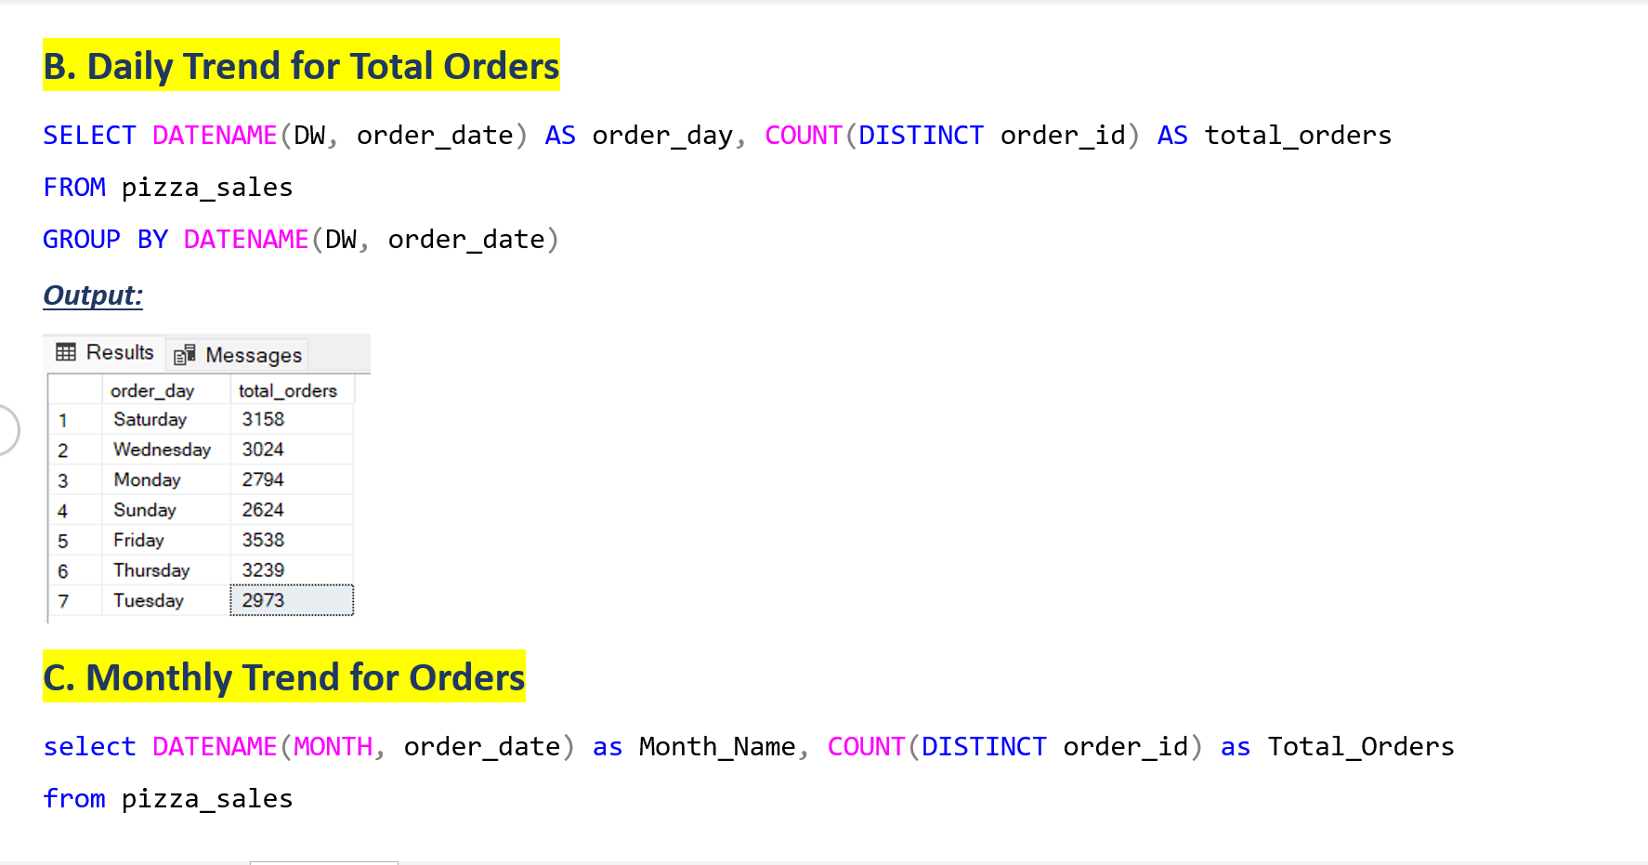
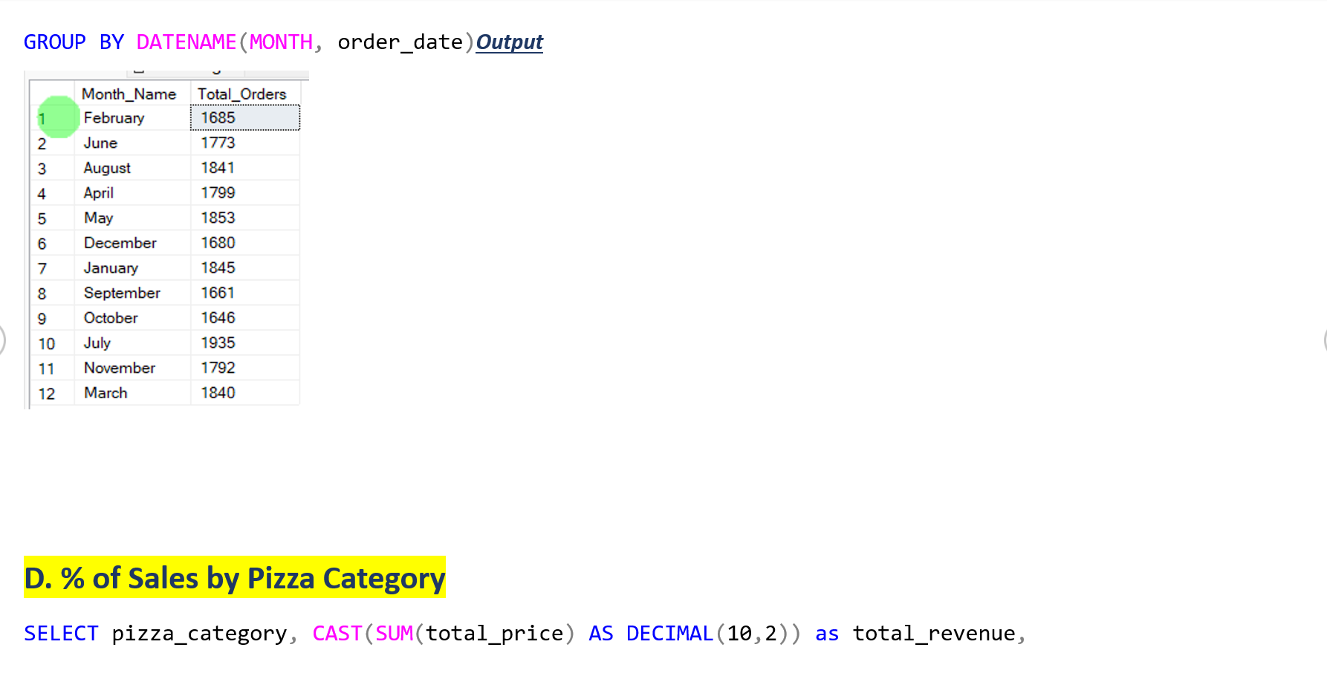

Slide 10
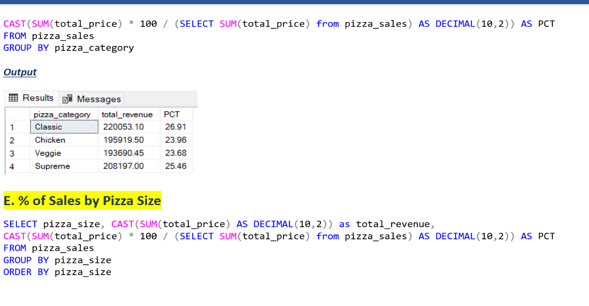
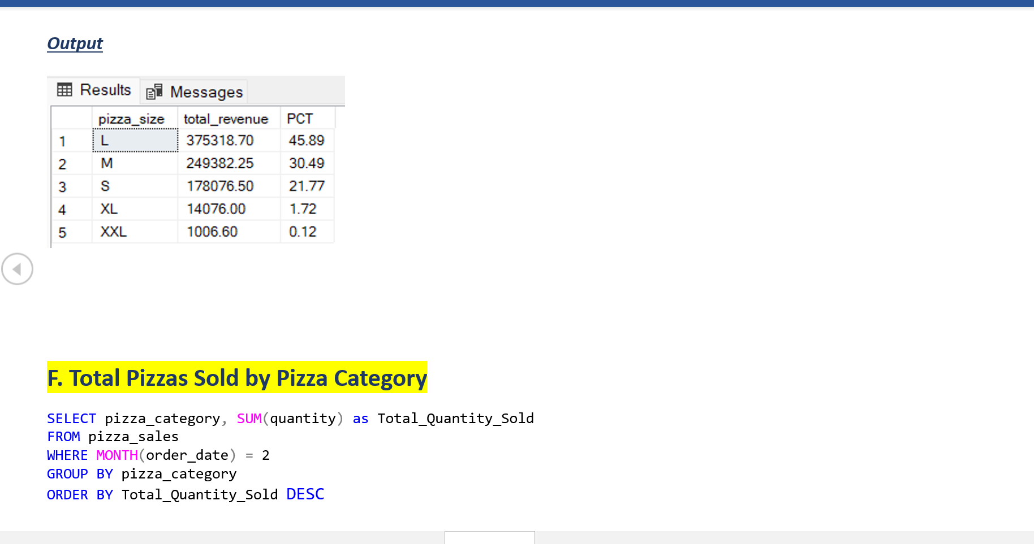
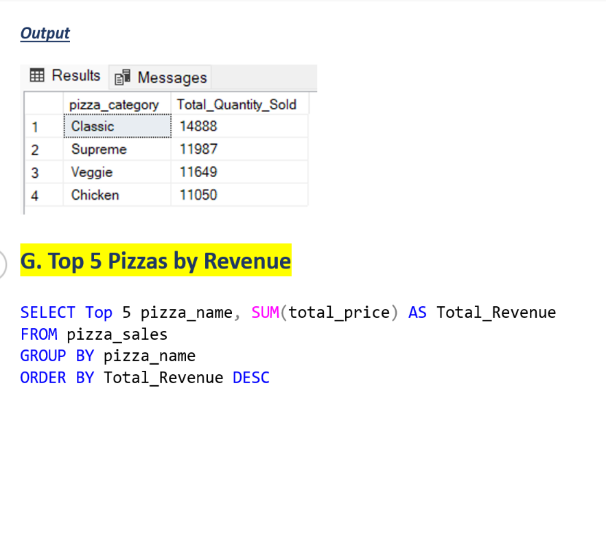
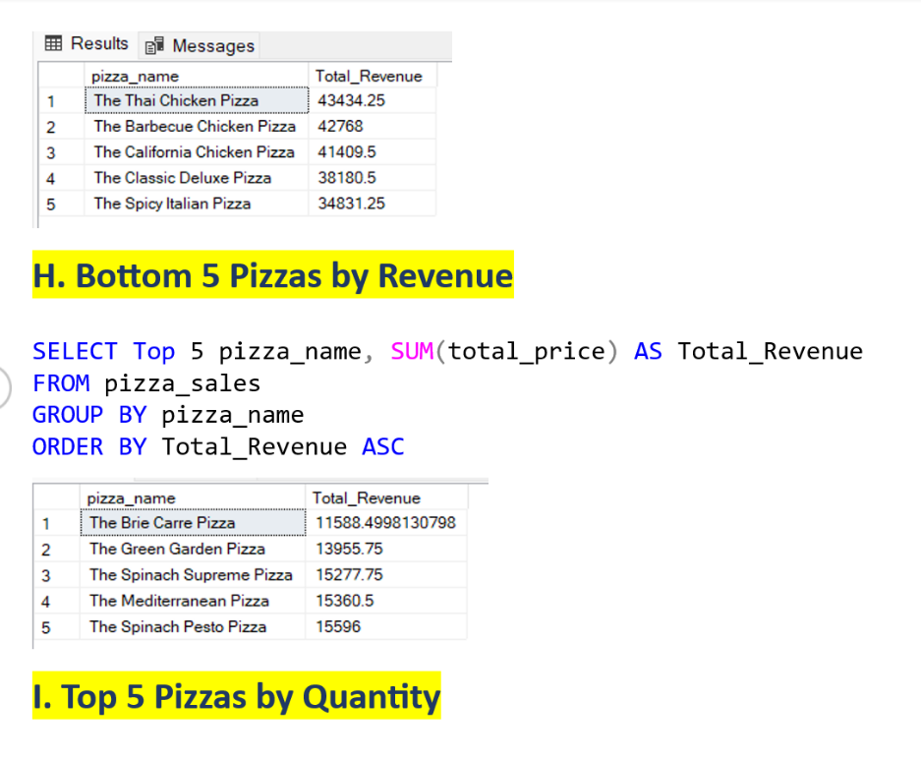
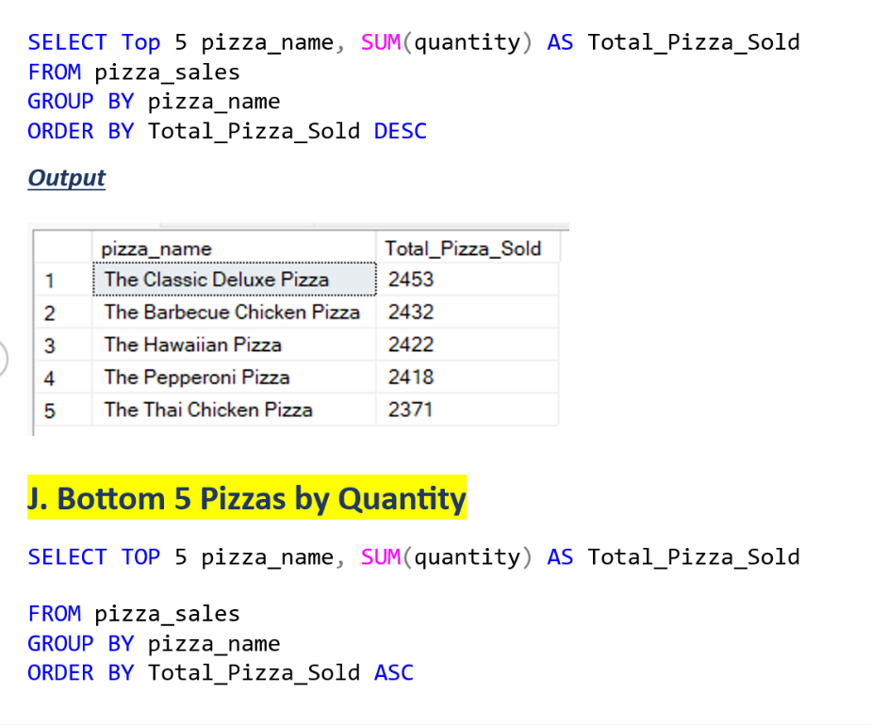

Slide 11
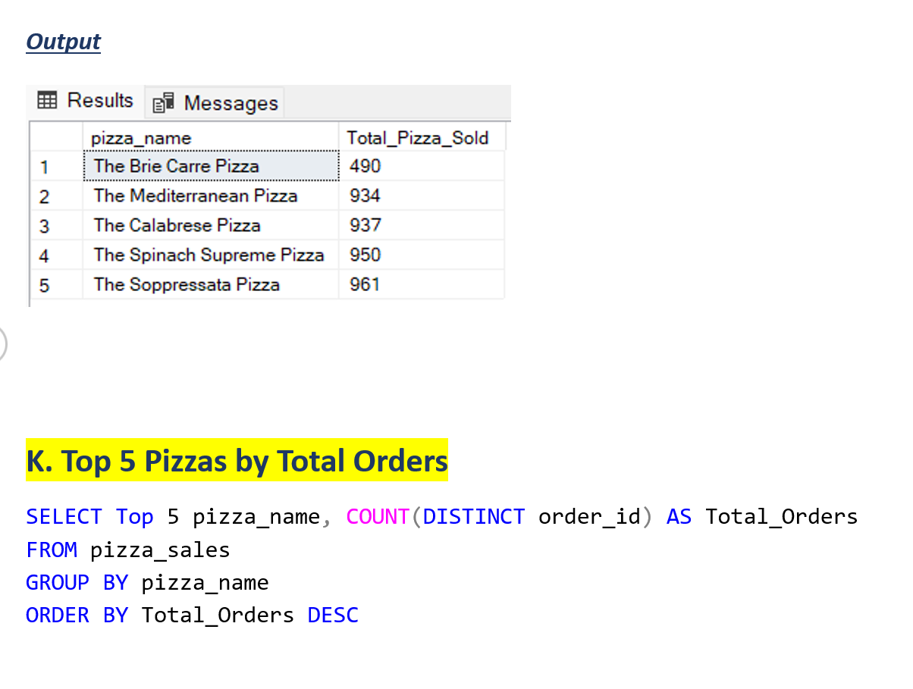
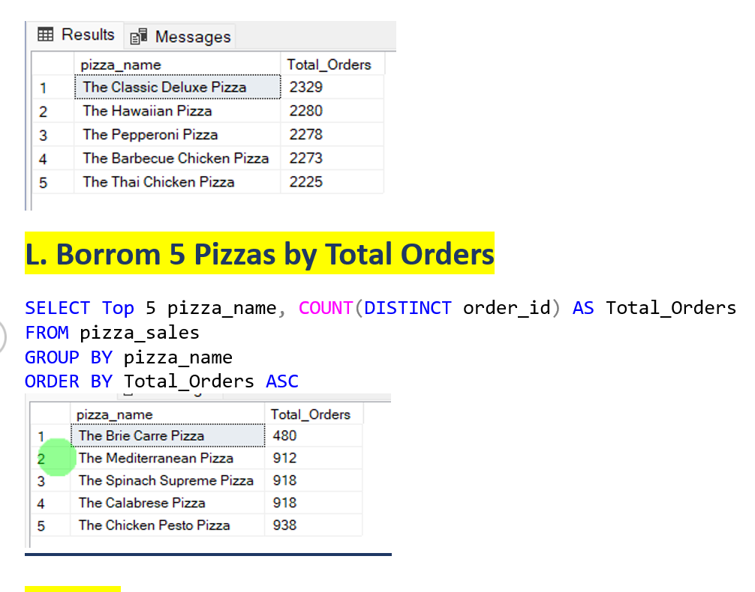

Slide 12

Conclusion
Busiest Day
DAYS: Orders are highest on weekends Friday, Saturday evenings.
MONTHLY: There are maximum orders from month of July and January.
Sales Performance
CATEGORY: Classic Category contributes to maximum sales & total orders.
SIZE: Large size pizza are contributes to maximum sales.

Slide 13




Conclusion
Best Sellers
REVENUE: The Thai Chicken Pizza Contributes to maximum Revenue.
QUANTITY: The Classic Deluxe Pizza Contributes to maximum Total Quantities.
TOTAL ORDER: The Classic Deluxe Pizza Contributes to maximum Total Orders.
Worst Sellers
REVENUE: The Brie Carre Contributes to minimum Revenue.
QUANTITY: The Brie Carre Pizza Contributes to minimum Total Quantities.
TOTAL ORDER: The Brie Carre Pizza Contributes to minimum Total Orders.

Slide 14
Best Sellers
REVENUE: The Thai Chicken Pizza Contributes to maximum Revenue.
QUANTITY: The Classic Deluxe Pizza Contributes to maximum Total Quantities.
TOTAL ORDER: The Classic Deluxe Pizza Contributes to maximum Total Orders.
Worst Sellers
REVENUE: The Brie Carre Contributes to minimum Revenue.
QUANTITY: The Brie Carre Pizza Contributes to minimum Total Quantities.
TOTAL ORDER: The Brie Carre Pizza Contributes to minimum Total Orders.

Slide 15
SOFTWARE USED
MS-EXCEL: VERSION 2021
MS SQL SERVER: 19.0
SQL SERVER MANAGEMENT STUDIO: SQL Server Management Studio 19.3.4.0
POWER BI: JUNE 2023 Version
POWERPOINT: VERSION 2021

Slide 16


